Slide 1
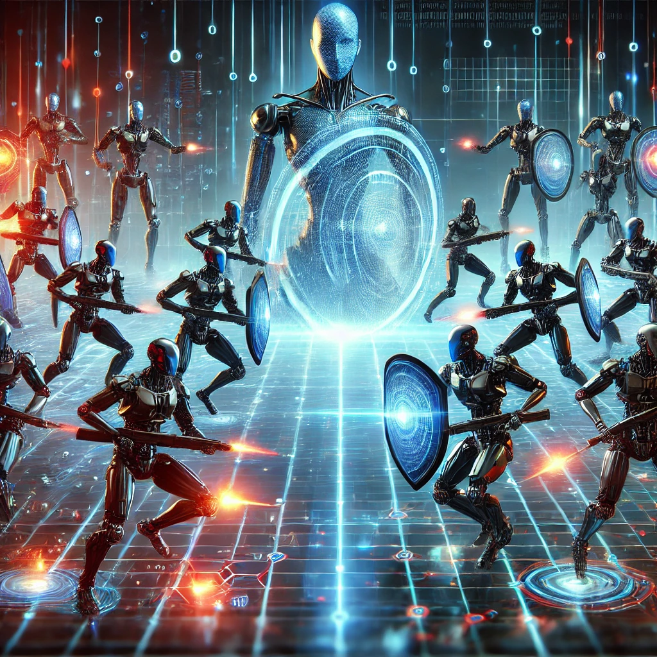
Interactive Labs for Machine Learning Cybersecurity

Slide 2
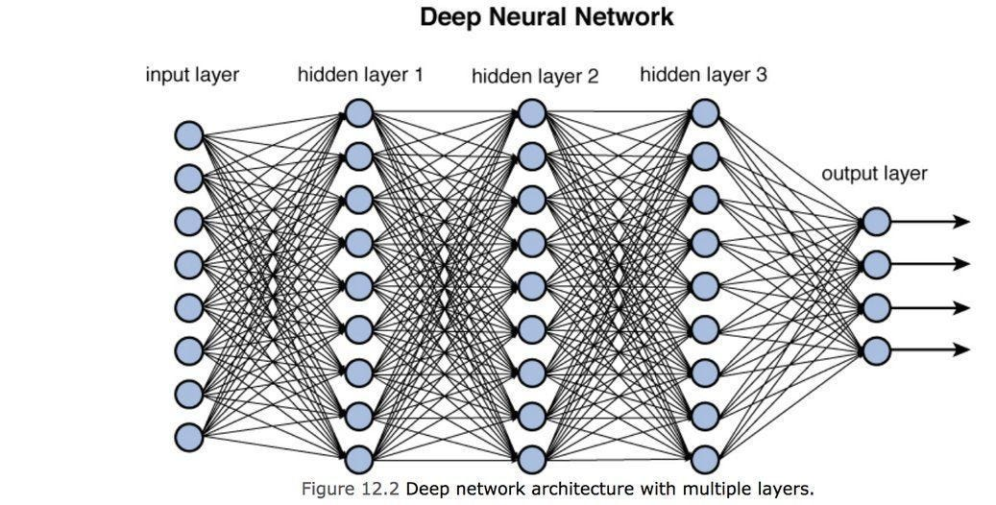
Understanding DNN
What is DNN?

Slide 3
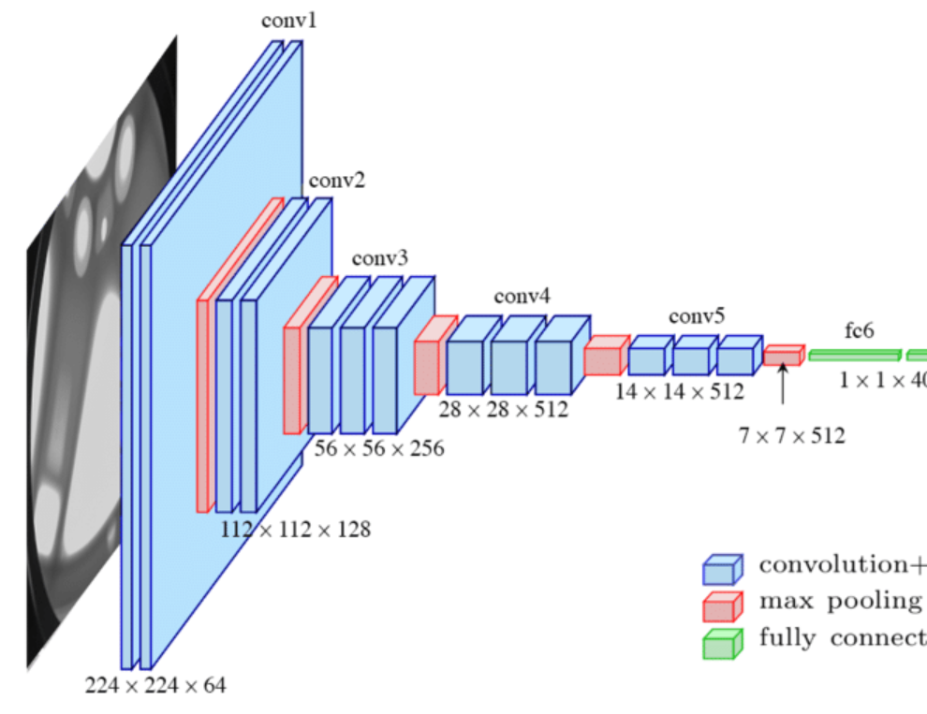
Understanding CNNs
What is CNN?
convolutional layers
pooling layers
fully connected layers

Slide 4
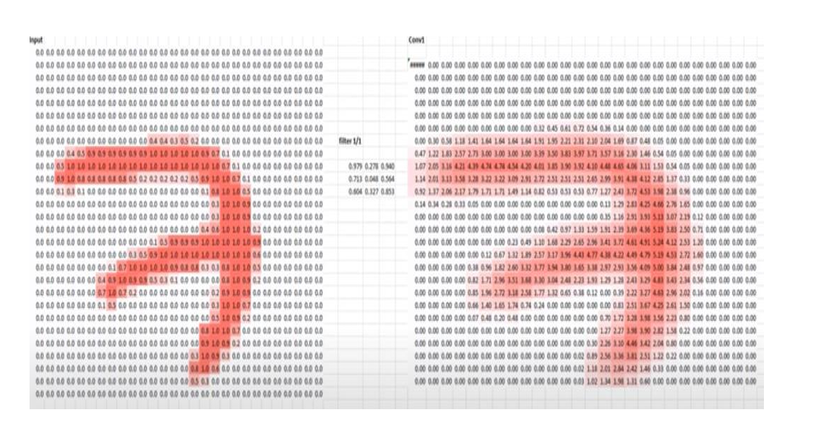
Feature map

Slide 5
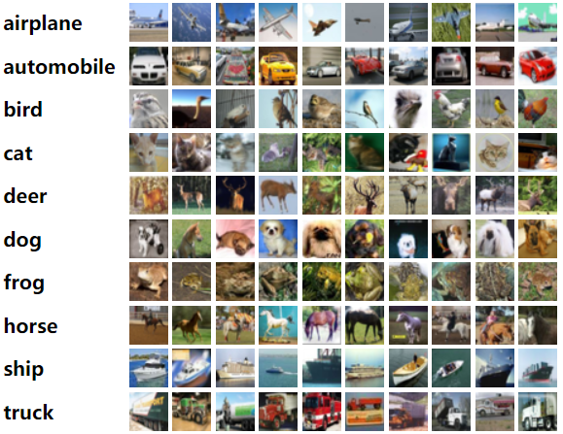
Understanding CNNs with CIFAR-10
What is CIFAR-10?
CIFAR-10 as a dataset containing 60,000 3x32x32 size color images across 10 classes (e.g., airplanes, cars, birds).

Slide 6
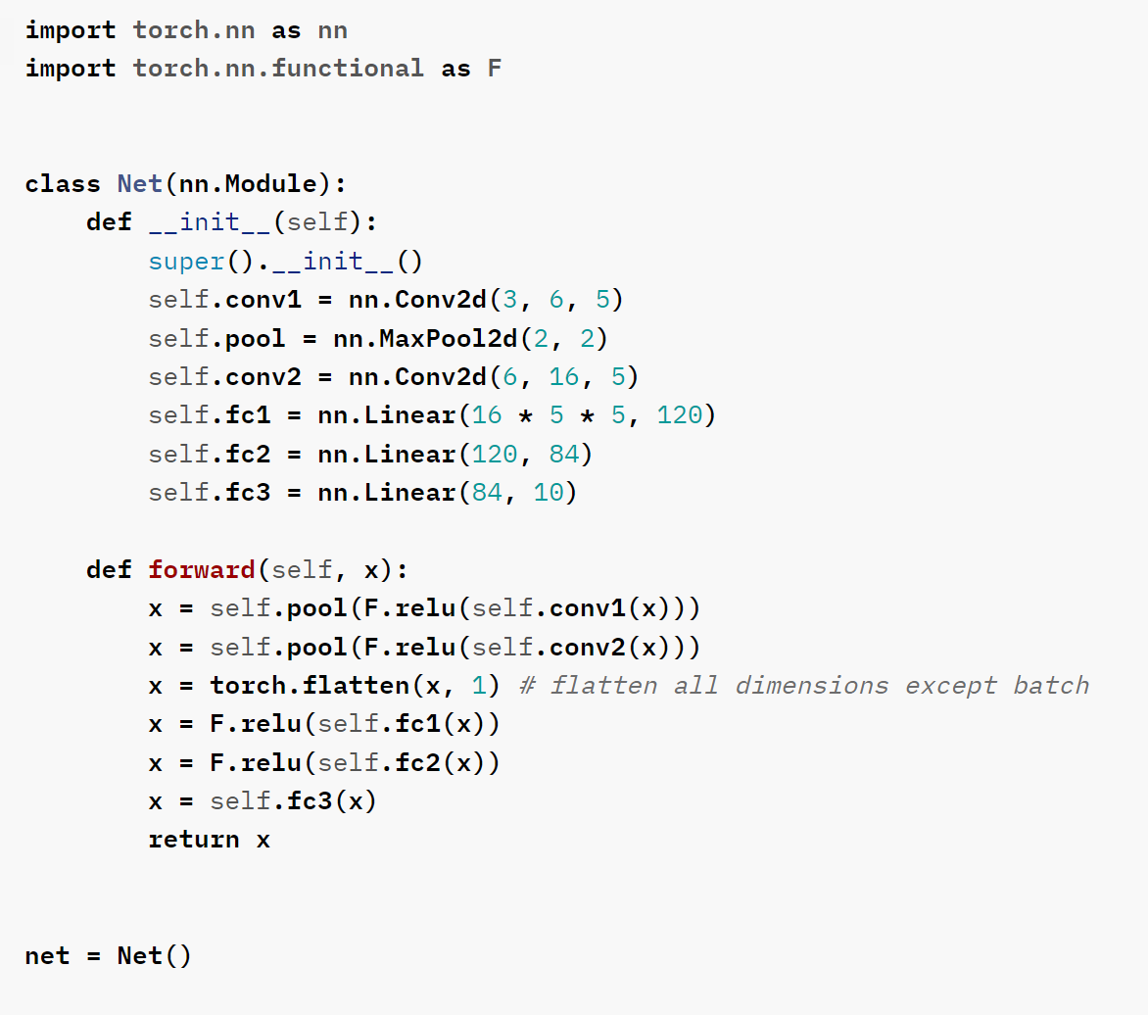
simple Convolutional Neural Network (CNN) in PyTorch

Slide 7
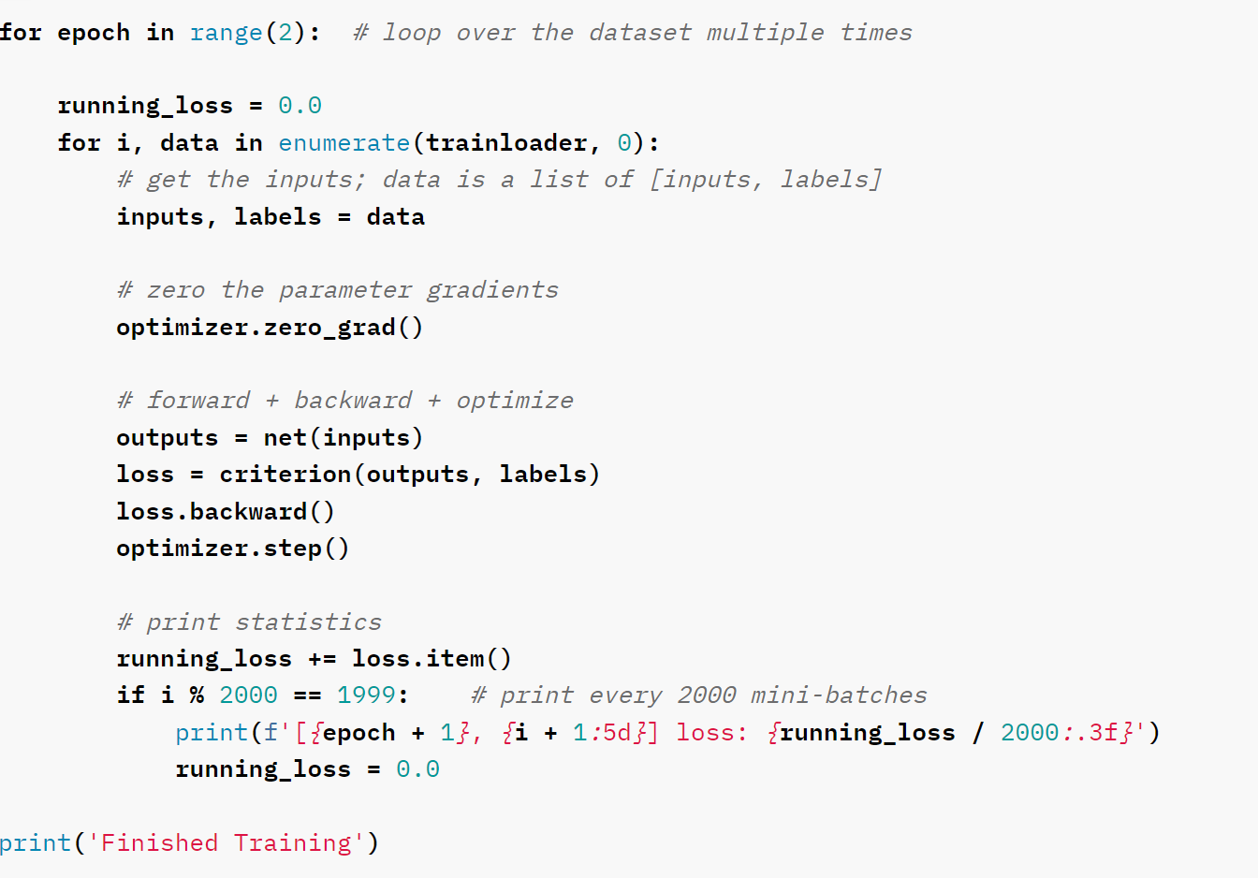
training process

Slide 8
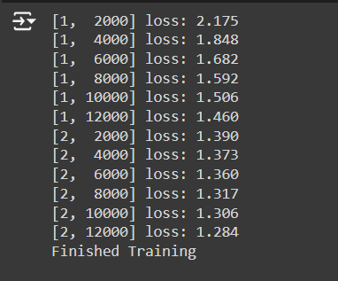
Output
https://colab.research.google.com/drive/1bSmJyzmlPKM30TGUmDQs9TffODLpZxvl?usp=sharing

Slide 9
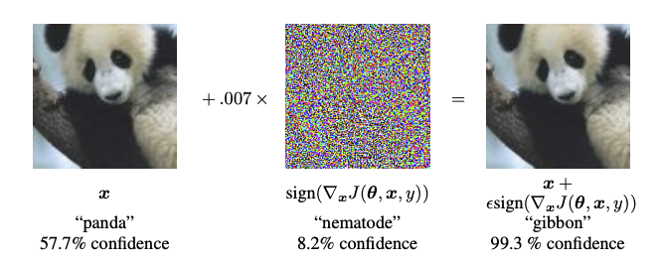
FGSM and Adversarial Attacks
What are Adversarial Attacks?
Small perturbations in input data can deceive neural networks.
What is FGSM?
A method to generate adversarial examples by adding perturbations in the gradient direction.

Slide 10
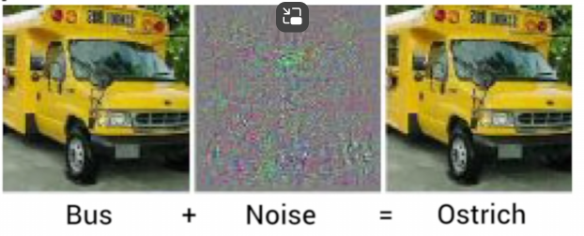
FGSM and Adversarial Attacks
Adding BARELY PERCEPTIBLBLE NOISE to fool the Neural Nets
Initially it was thought it would take around 100 pixels to
execute Adversarial Attacks
But it was found later in a research paper that we can change
the output of the neural networks by changing Just 1 Pixel !!

Slide 11
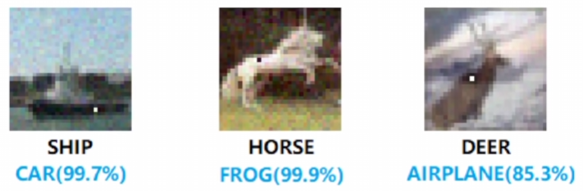
FGSM and Adversarial Attacks
One Pixel Attack
The famous one-pixel attack which changes the course of output by changing only 1 Pixel.
Reference: [1905.02175] Adversarial Examples Are Not Bugs, They Are Features (arxiv.org)

Slide 12
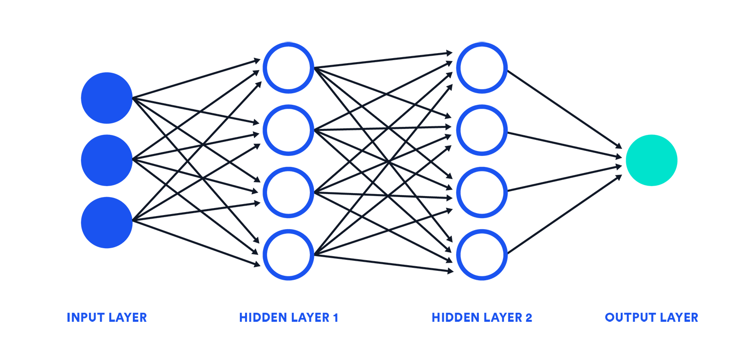
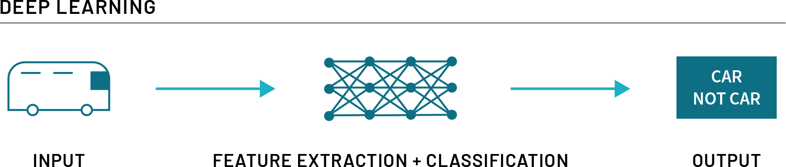
Adversarial attacks
(Depending on the
attackers' knowledge)
White Box
Black Box
Assuming attacker has full knowledge and access to the model, including architecture, inputs, outputs, and weights
Assuming attacker has only control over inputs, ouputs and knows nothing about underlying architecture or weights.

Slide 13

Fast Gradient Sign Attack
These manipulate input images using the gradients of pre-trained models.
These maximise the loss function thereby causing misclassification.
The epsilon ε is a hyperparameter here which is Crucial for this process.

Slide 14
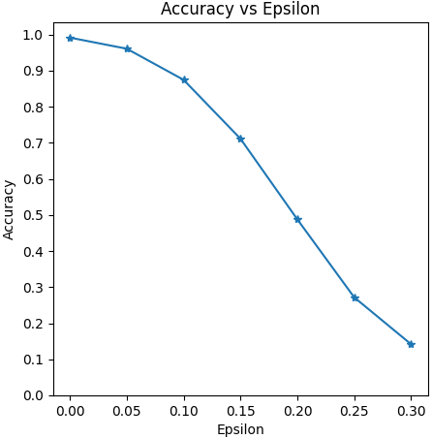
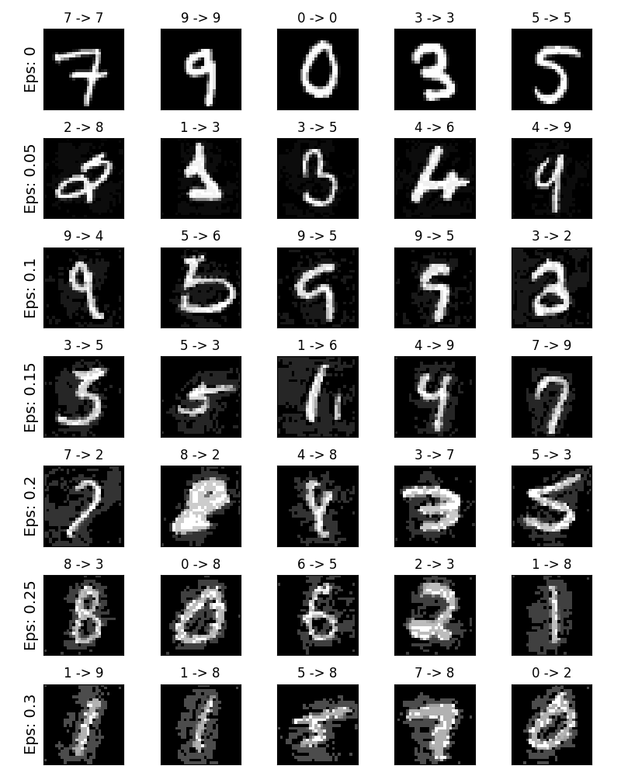
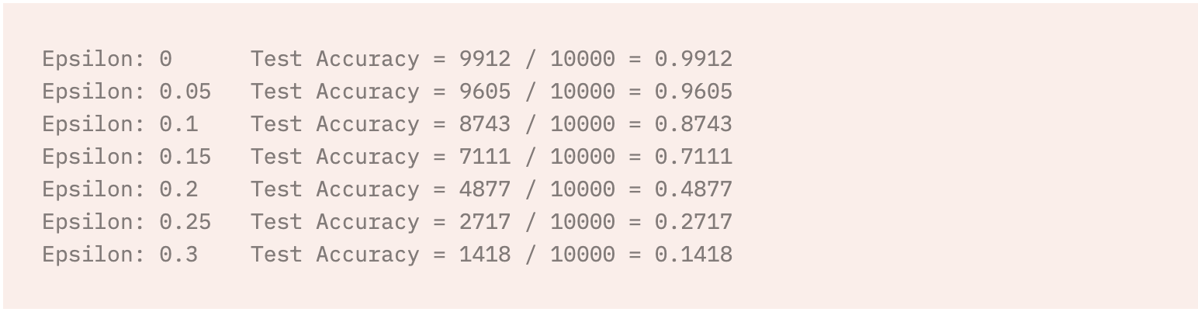
FGSM Results
Larger the epsilon, the more effective the attack in terms of degrading model accuracy (as observed in the graph)
Epsilon vs Perceptibility trade off:
Although accuracy and epsilon are almost inverse in behaviour,
the perturbations become more easily perceptible if epsilon is large.

Slide 15

Cleverhans library overview
Purpose
create, benchmark, and defend against adversarial examples.
Features
attacks, defenses, and utilities for adversarial ML research.
Community-driven:
widely used in the adversarial ML research community.
https://github.com/cleverhans-lab/cleverhans

Slide 16

Types of Adversarial Attacks
L-BFGS Method
Fast Gradient Sign Method (FGSM)
Carlini-Wagner Attack
Elastic Net Method
Basic Iterative Method
Projected Gradient Descent
Jacobian-based Saliency Map Approach
DeepFool

Slide 17

THANK YOU

